Slide 1

Physics 1
Voronkov Vladimir Vasilyevich

Slide 2
Physics 1
Mechanics
Molecular physics and Thermodynamics
Electricity
Magnetism

Slide 3
Lecture 1
Mechanics
Kinematics
Rectilinear motion
Projectile motion
Uniform circular motion
Dimensions and units

Slide 4
Mechanics
Mechanics is the science of motion and its cause.
Kinematics is the mathematical description of motion.

Slide 5
Main terms of Kinematics
Displacement is the change in the position of an object.
one-dimensional: ∆x= x₂ - x₁
many-dimensional:
Average velocity is the distance traveled per unit of time:
Instantaneous velocity is the velocity at infinitely small interval:
or the same

Slide 6
Average acceleration is the total change in velocity per interval of time:
Instantaneous acceleration is the change in velocity per unit of time at infinitely small time:
Gravitational motion is the motion when gravitational acceleration g=9.8 m/s² takes part. For example: rocket motion.

Slide 7
Displacement at constant acceleration in rectilinear motion :
Where r₀ and V₀ is initial displacement and velocity at t=0, a is constant acceleration.

Slide 8
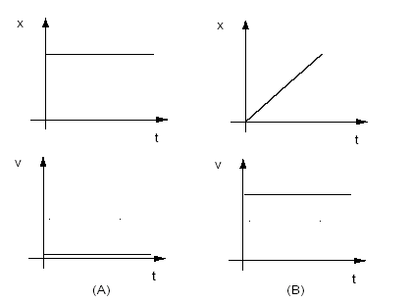
Rectilinear motion in graphics
A) Object stands still.
B) Object moves with constant speed.

Slide 9
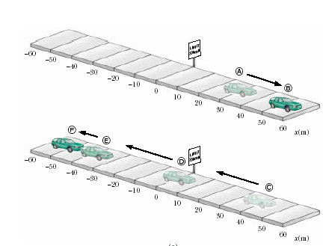
Another example of rectilinear motion

Slide 10
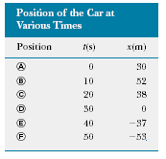
The car motion in table

Slide 11
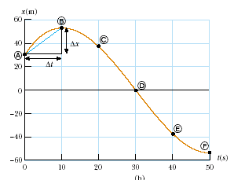

Slide 12
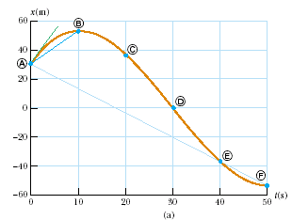
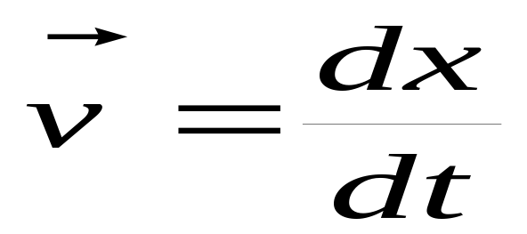

Slide 13
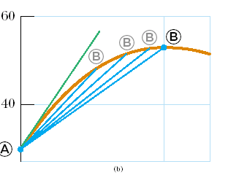
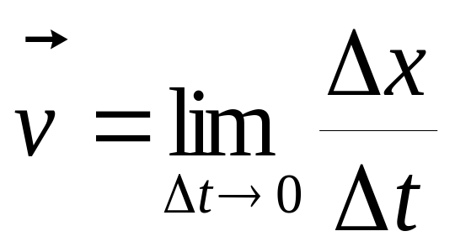

Slide 14
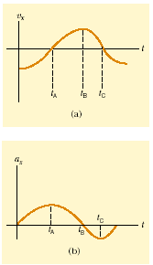
Velocity and acceleration

Slide 15
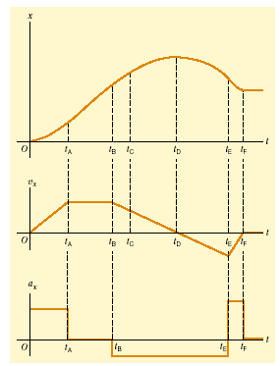

Slide 16
Projectile motion is a gravitational motion but the object has no its own acceleration. So the motion goes with constant gravitational acceleration. For example: cannonball motion.
Usual method for solving projectile motion problems:
  Separate the motion into two parts: vertical and horizontal: so we have:
    two coordinates x and y
    two velocities V_{x} and V_{y}
    one acceleration a_{y} =-g, and a_{x}=0

Slide 17
  Then one should determine the elevation angle Θ₀ - the initial angle to horizon.
  So the trajectory of an object in the gravitational field can be described as following:
  x= V₀CosΘ₀ t,
  y= V₀SinΘ₀ t – gt²/2.
  Let’s designate R as the range the object travels from zero height (y=0) till its fall (y=0 again) then we can calculate it as
  R=V₀²Sin(2Θ₀)/g.
  Flight time t: it’s easy (using the equation dy/dt = 0) to find that the time of ascent is V₀SinΘ₀/g, then the full flight time is double:
  t_{flight}= 2V₀SinΘ₀/g.
  Using the flight time one can find:
  the maximal height,
  the range of flight (the maximum range of flight from zero height (y=0) till the fall of the object (y=0 again)).

Slide 18
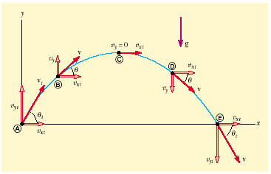

Slide 19
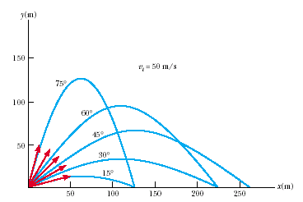
R =V₀²Sin(2Θ₀)/g

Slide 20
Uniform circular motion
Uniform circular motion is performed with constant speed along a circular path. Circular motion is a special case of motion on a plane. Its coordinates is angular coordinate φ and radius r. The angular speed ω is defined as:
The linear velocity relates to the angular velocity as:
Period T is the time of one full revolution:
T= 2π/ω.

Slide 21
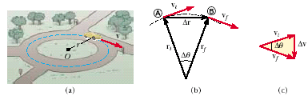

Slide 22
Dimensions and Units
Basic mechanical dimensions:
M – mass
L – length
T – time

Slide 23
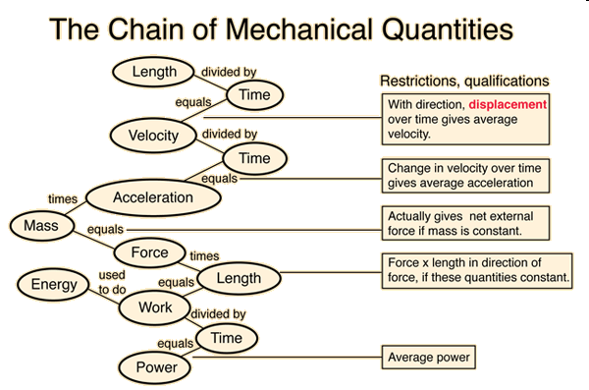

Slide 24
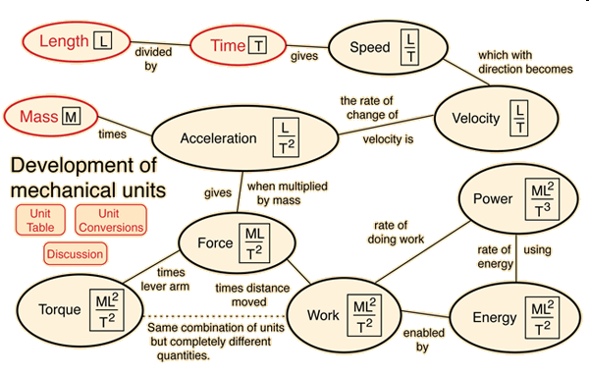

Slide 25
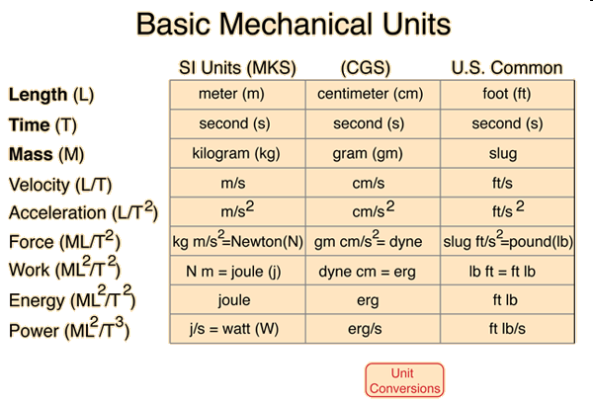

Slide 26
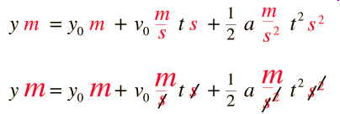
Dimensional Analysis
Having the same units on both sides of an equation does not guarantee that the equation is correct, but having different units on the two sides of an equation certainly guarantees that it is wrong!

Slide 27
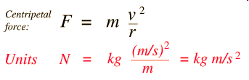


Slide 28
Units in SI
Displacement x,y m
Velocity V m/s
Acceleration a,g m/s²
Angle φ rad
Angular speed ω rad/s
Period T s

